Slide 1

Food & Nutrition Services Update
Althea Albert-Santiago, MPH, CCNP, CMP
Director of Food and Nutrition Services
Erika Hollinshed, MA
Catering Services Specialist
Faith Fude, MS, RD,
Nutrition Coordinator
Presented to: Family and Community Specialists
August 11, 2022
Putting Child Nutrition First

Slide 2
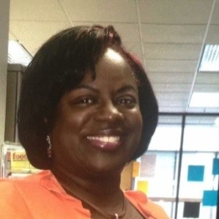
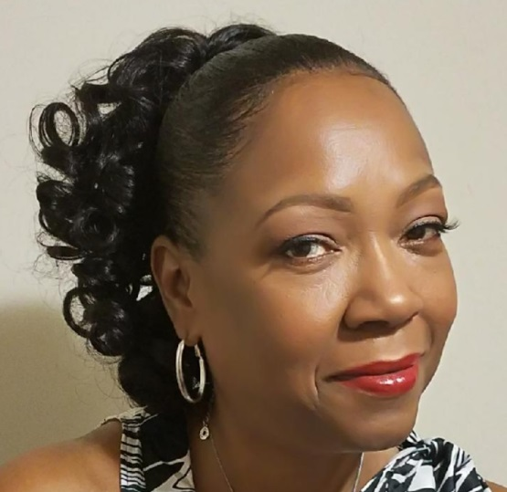
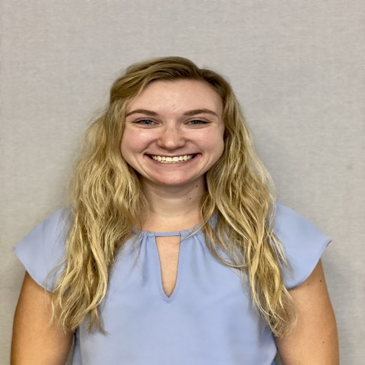
Food & Nutrition Services Leadership Team
Althea Albert-Santiago, MPH, CCNP, CMP
Director of Nutrition Services
Carolyn Penn
General Manager of Foodservice
Faith Fude, MS, RD
Nutrition Coordinator
2

Slide 3

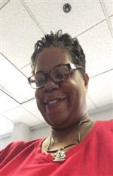
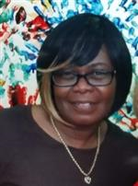
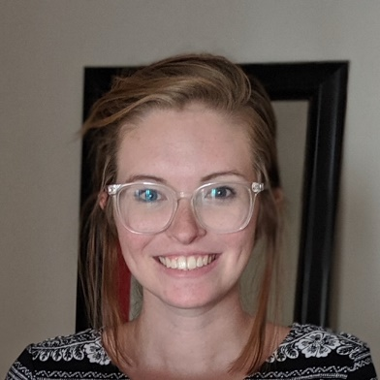
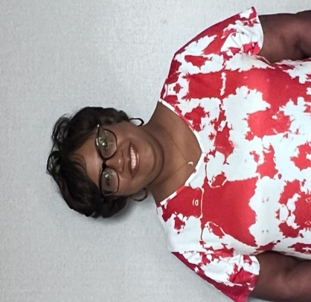
Food & Nutrition Services Leadership Team
Tenecia Williams
Accountability Specialist
Erika Hollinshed
Catering Services Specialist
Jackie Martin-Baker
Assistant to the General Manager
Serena McPhail, RD
Nutrition Coordinator/ Roving Chef
Ernestine Dodson
Nutrition Coordinator II
3

Slide 4

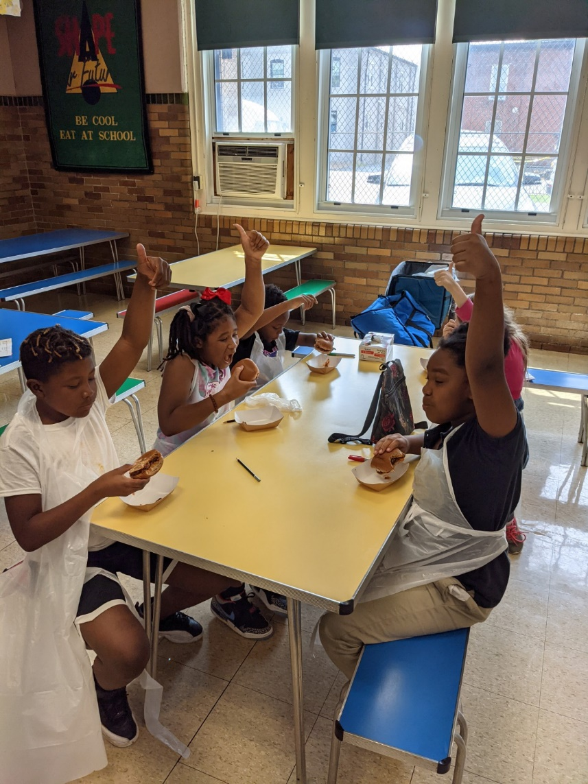
Community Eligibility Provision
Saint Louis Public Schools (SLPS) continues to operate the Community Eligibility Provision (CEP) Program under the United States Department of Agriculture Department (USDA) and Missouri Department of Elementary and Secondary Education (DESE).
The District will offer both free breakfast and lunch to all St. Louis Public Schools students.
All food programs are required to have written approval by Althea Albert-Santiago, Director of Food and Nutrition Services.
4

Slide 5
National Schools Breakfast Lunch Programs
Saint Louis Public Schools operates the Community Eligibility Provision Program, which allows all SLPS school students to eat a free breakfast, lunch, and snack.
Breakfast Program
  Breakfast served in the cafeteria
  Breakfast in the Classroom
  Grab ‘N Go Carts
  Second Chance Breakfast
Lunch Program
  Lunch served in the cafeteria
  Lunch in the classroom
  Grab ‘N Go Carts
All food programs are required to have written approval by Althea Albert-Santiago, Director of Food and Nutrition Services
4

Slide 6
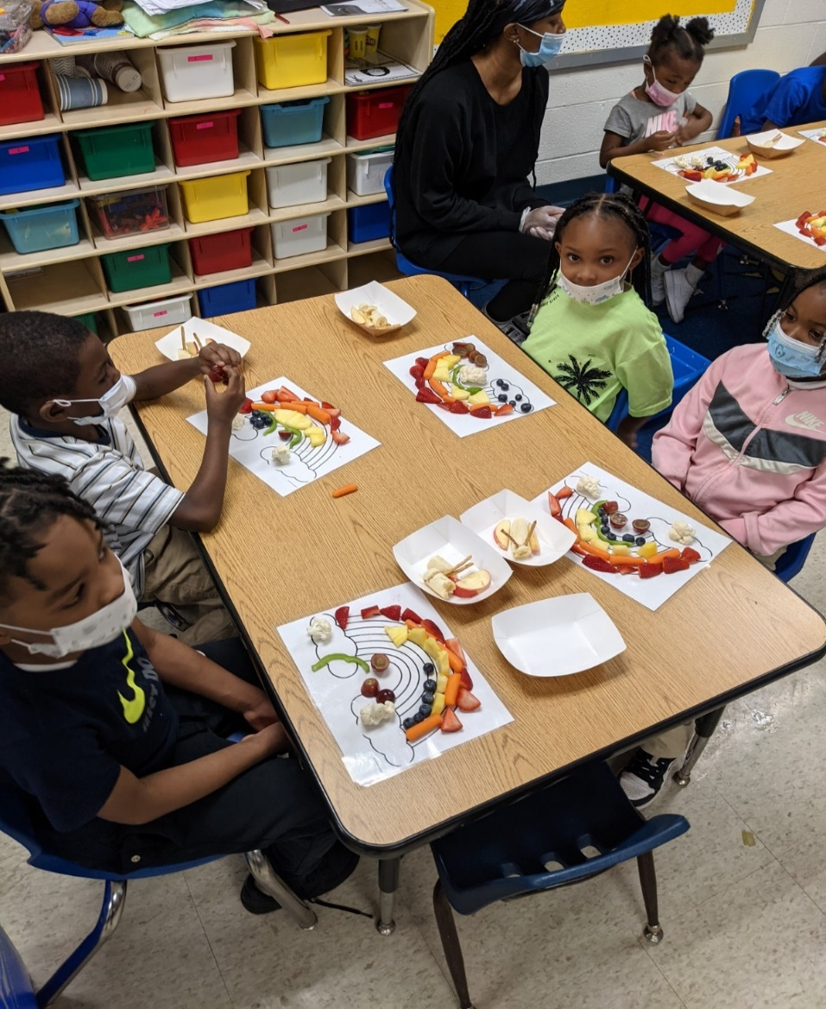
Fresh Fruit and Vegetable Program
The Goal of the FFVP
Create healthier school environments by providing healthier food choices
Expand the variety of fruits and vegetable children experience
Increase children’s fruit and vegetable consumption
Make a difference in children’s diets to impact their present and future health
How Schools are Selected
Be an elementary school
Have a high percentage of students eligible for the Community Eligibility Provision Program
Make free fresh fruits and vegetables available to all enrolled children
Provide fresh fruits and vegetables only during the school day (not before or after school or during summer school)
Widely publicize within the school the availability of free fresh fruits and vegetables
Have documented support of the food service manager, principal and district superintendent
Serve free fresh fruits and vegetables outside of the NSLP and SBP meal periods five days per week
The staff works with the FFVP coordinator
For additional information, please contact:
Tenecia Williams, Accountability Specialist
Tenecia.williams@slps.org or 314-345-2308
7

Slide 7

Catering Services
Booking An Event
Contact and email Erika Hollinshed, Catering Services Coordinator in Food Nutrition Services, for all catering requests.
Please copy Carolyn Penn, SFE General Manager of Food Services Carolyn.Penn@sfellc.org, and Althea Albert-Santiago, Director of Food and Nutrition Services Department Althea.Albert-Santiago@slps.org on all catering requests.
Catering requests must be submitted via email Monday-Friday by 3 pm. The next day catering orders will not be accepted.
Complete the Saint Louis Public Schools Catering Request Form within Seven (7) days from the day of the event.
The Catering Request Form, Order Confirmation, and Invoice will be emailed within 24 hours after booking the event
After the event client must complete all required forms for payment (i.e. Checklist for invoice payments and reimbursements, voucher certification forms, etc., and submit all payments to Stephanie Morris, Accounts Payable Supervisor at stephanie.Morris@slps.org. Contact number: 314-345-2278.
For additional information, please contact:
Erika Hollinshed, Catering Services Coordinator
Erika. Hollinshed @slps.org or 314-331-6115
8

Slide 8
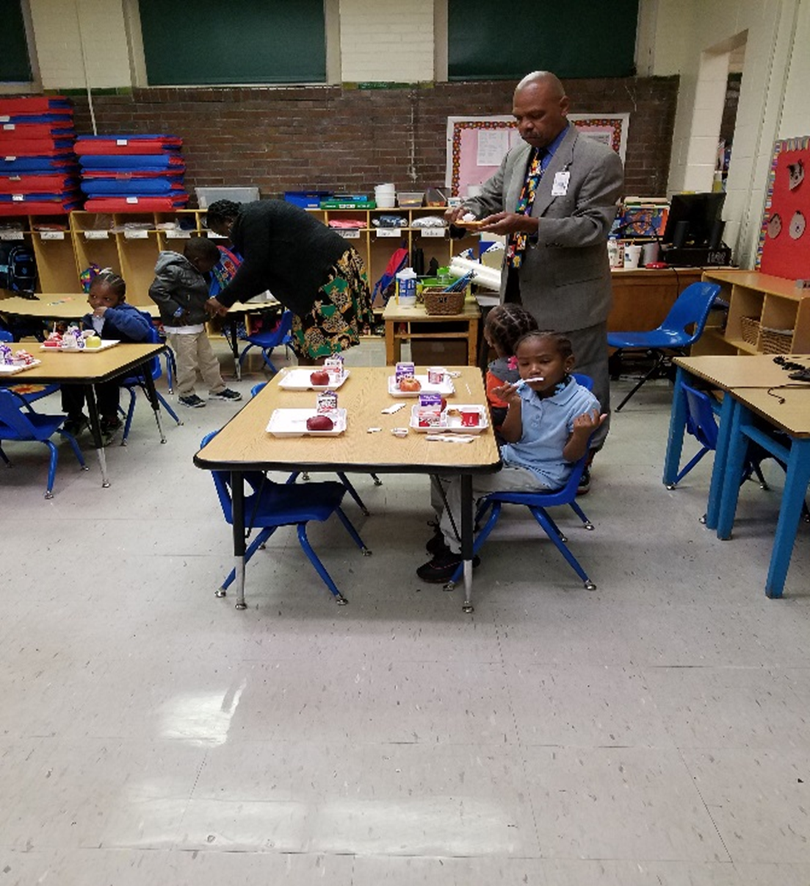
Compliance Guidelines
Menus and Service Times
Service times cannot be changed without a written request to Althea Albert-Santiago, Director of Food
and Nutrition Services
All service times are approved by the Department of Elementary and Secondary Education (DESE)
In School Suspensions
United States Department of Agriculture (USDA) states you cannot punish students with food
Students must receive a reimbursable meal
The Child and Adult Care Food Program (CACFP)
Afterschool Supper and Snack Program is sponsored by the Missouri Department of Health and Senior Services ​
Schools that provide an afterschool program that includes educational, enrichment, and athletics programs are eligible to participate ​
Schools can receive hot or cold meals ​
Protocol: All schools requesting supper and snacks will need to submit written a request to Althea Albert-Santiago
5

Slide 9
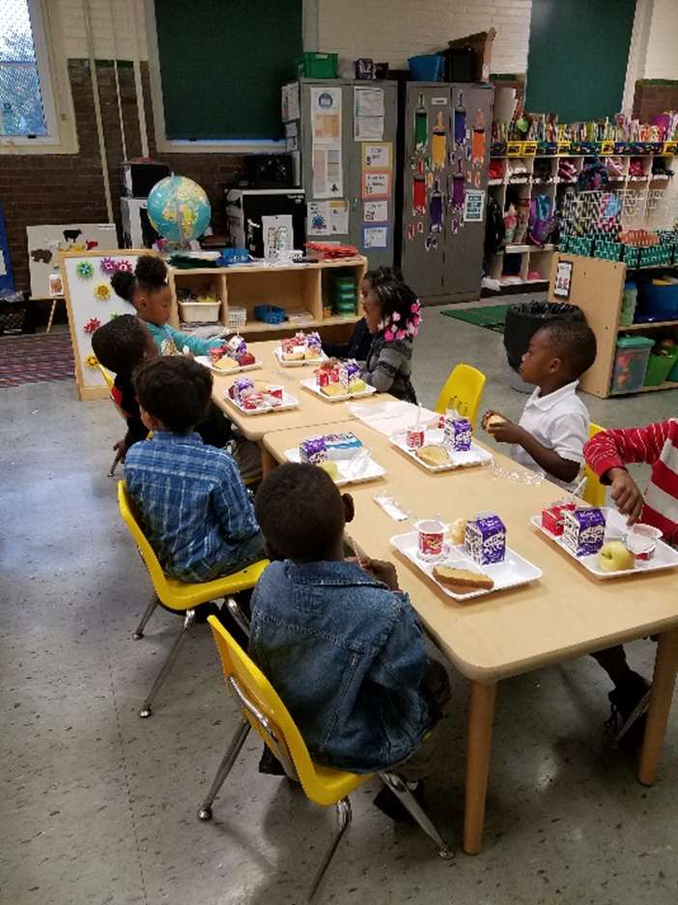
Compliance Guidelines
Smart Snack Guidelines include changes in calories, sodium, fat, and sugar for snacks and beverages and regulate vending machines, fundraisers, and school stores.
Schools Stores
St. Louis Board of Education Regulation: Business and Non-Instructional Operations Policy R3542.2.3
Only allowed to sell non-food items during the school day.
No food items will be sold during breakfast or lunch in competition with the National School Breakfast and Lunch Program.
Fundraisers
Non-food item fundraisers are allowed during the school day.
The standards only apply during school hours (midnight the night before to 30 minutes after the school day ends)
Protocol: All schools requesting fundraisers will need to submit a written request to Althea Albert-Santiago
Check fundraisers’ ideas on Food and Nutrition webpage.
Water
Water is offered to all students during breakfast and lunch.
6

Slide 10

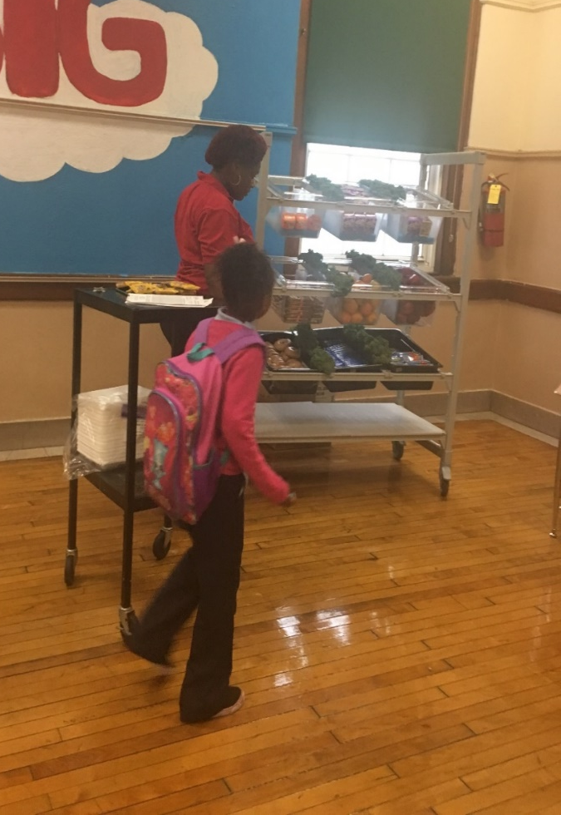
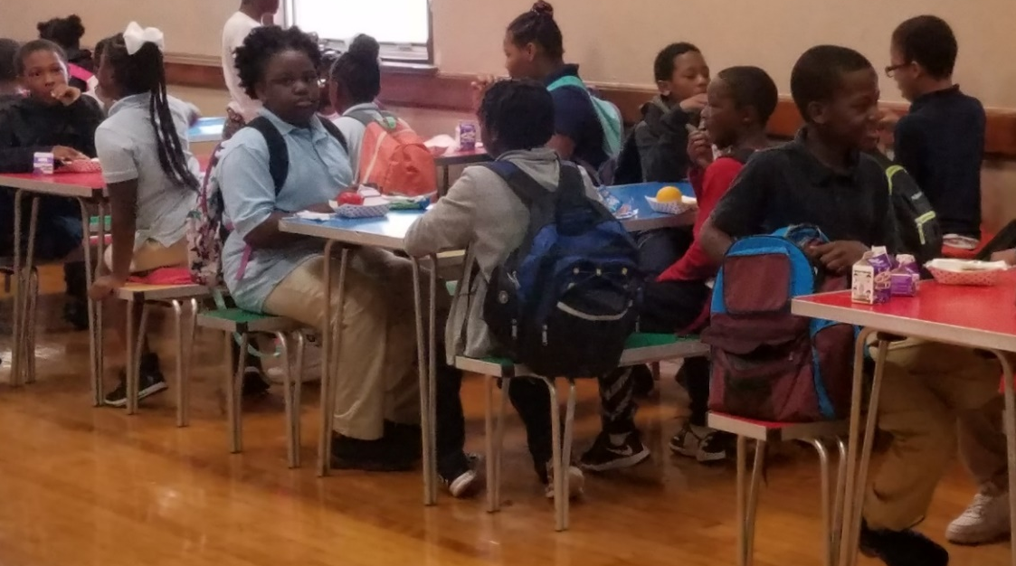
Second Chance Breakfast
Each school will have a Grab and Go Second Chance Breakfast Cart.
This will be a second chance option for students arriving after the bell.
The students will have the option to take breakfast items to the classroom.
9

Slide 11

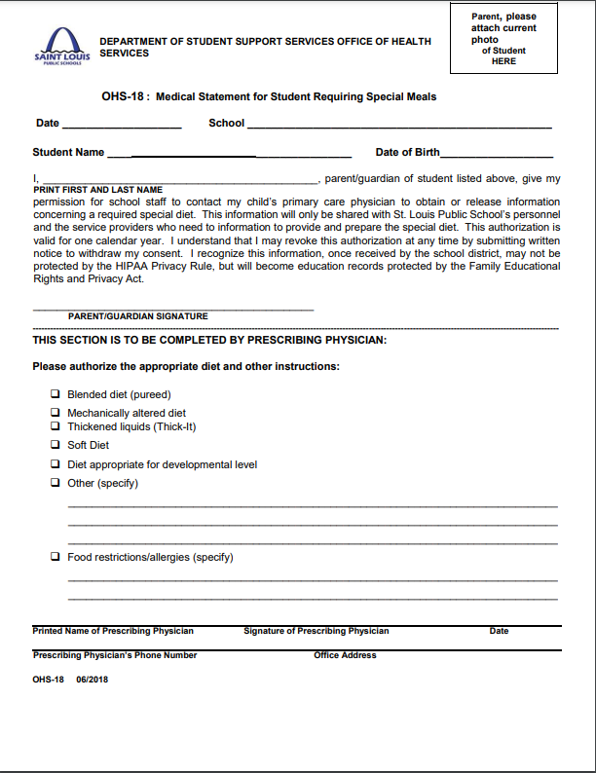
Special Diets
Special Diet form (OHS-18)
Written documentation from a licensed practitioner
  Diet order
    Identification of the medical or other special dietary condition which restricts the student’s diet
    The food or foods omitted from the student’s diet
    The food or choice of foods to be substituted
  Signature from a licensed practitioner
New documentation is needed each year to the school nurse or administrator
The health and nutrition team will create a new menu based on the student’s dietary needs
  The food service staff will prepare the meal for the student
11

Slide 12
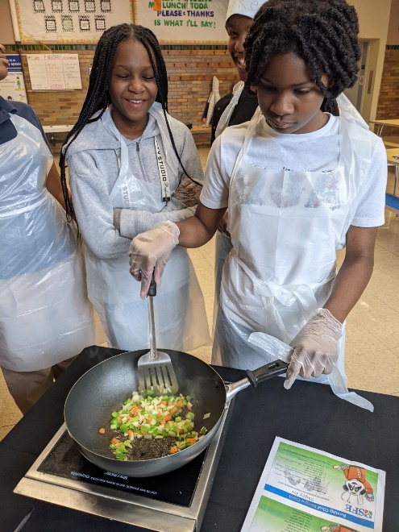
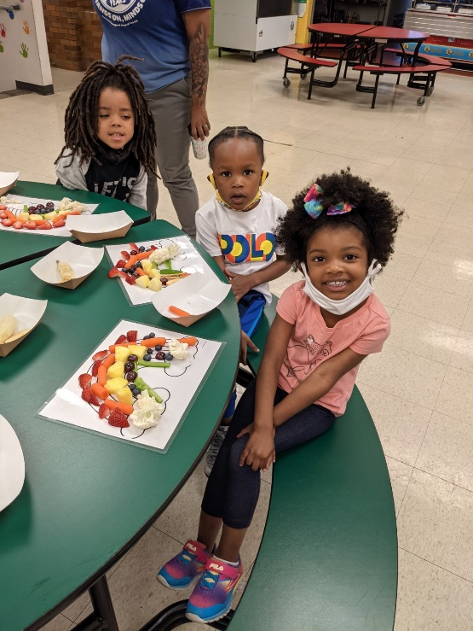
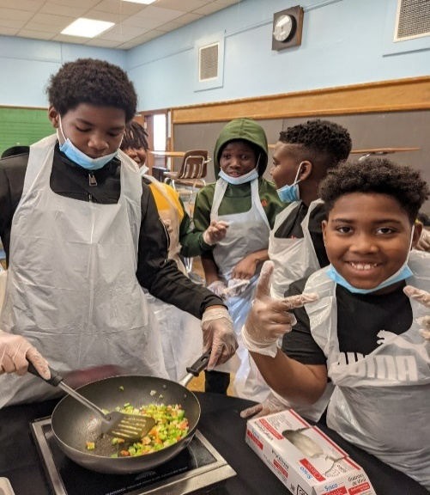
Roving Chef, Rainbows & Butterflies, & Nutrition Education Classroom Program
Roving Chef Program Overview
A District Chef and Registered Dietitian will present an interactive cooking class with the students
Students will learn basic culinary terms and understand the benefits of eating healthy
10-12 students are in each class and each class is 45 minutes
Kitchen tours are offered as a component of the class
Students are given a Certificate of Participation along with a copy of the recipe
Rainbows & Butterflies Overview
Conducted by the Health and Nutrition Team
Geared for PreK-1st Grade
Students learn fruit and vegetable basics
Nutrition Education Classroom Program Overview
Presented by the Health and Nutrition Team
Nutrition Educations Topics: Healthy Eating, MyPlate basics, The Importance of Breakfast, and Portion Control
15-30 students are in each class and each class is 45 minutes
Interactive Activities: Taste Testing and Food Demonstrations
13

Slide 13

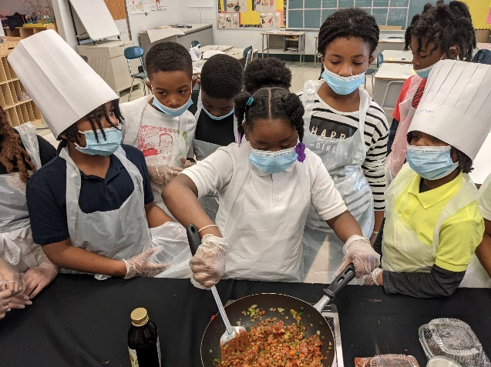
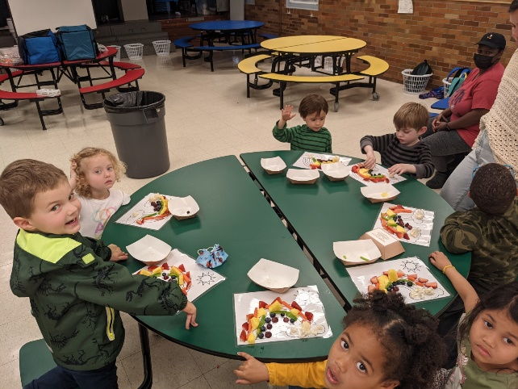
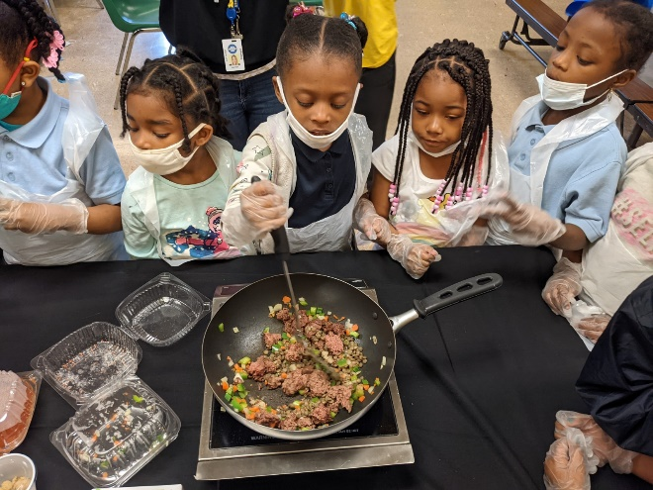
Roving Chef, Rainbows & Butterflies, & Nutrition Education Classroom Program
How to Book
Principals and teachers should contact
  Althea Albert-Santiago, Director of Food and Nutrition Services, 314-934-5302 althea.albert-santiago@slps.org
  Faith Fude, Nutrition Coordinator II, 314-381-4155 faith.fude@sfellc.org
After the Principals contact Althea Albert-Santiago or Faith Fude, the Principals will schedule the Roving Chef Program and the Nutrition Education Classroom Programs starting Monday, September 19, 2022.
After the event is booked, the Principals will receive a confirmation letter including dates, times, and procedures for preparing for the Roving Chef Program and the Nutrition Education Classroom Program within five business days.
If the Principals do not receive their confirmation letter within five business days, they should contact Althea Albert-Santiago at 314-934-5302 althea.albert-santiago@slps.org or Faith Fude at 314-381-4155 faith.fude@sfellc.org.
14

Slide 14

Contacts Information
Food and Nutrition Services
Althea Santiago,
Director Food and Nutrition Services
althea.albert-santiago@slps.org
District Cell Number: 314-934-5302
Office Number: 314-345-4519
Tenecia Williams,
Accountability Specialist
tenecia.williams@slps.org
Office Number: 314-345-2308
Erika Hollinshed,
Catering Services Coordinator
erika.hollinshed@slps.org
Number: 314-331-6115
Southwest Foodservice Excellence (SFE)
Carolyn Penn,
General Manger of Foodservice
carolyn.penn@sfellc.org
District Cell Number: 314-637-4841
Office Number: 314-381-4155
Jackie Martin-Baker
Assistant General Manager of Foodservice
jackie.martin-baker@sfellc.org
District Cell Number: 314-229-4746
Office Number: 314-381-4155
Faith Fude, MS, RD
Nutrition Coordinator III
faith.fude@sfellc.org
Office Number: 314-381-4155
This institution is an equal opportunity provider
15

Slide 15

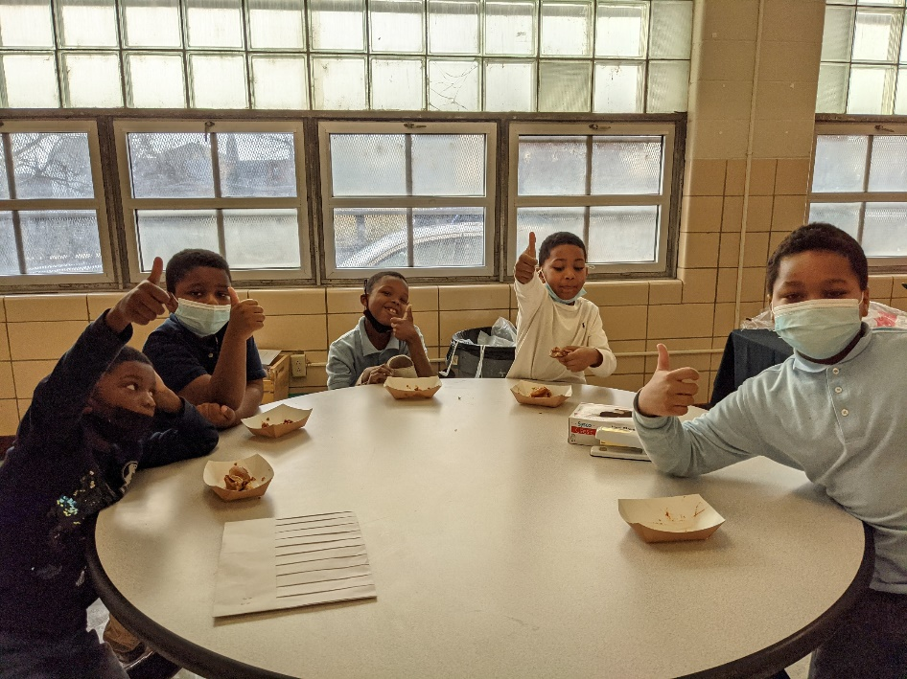
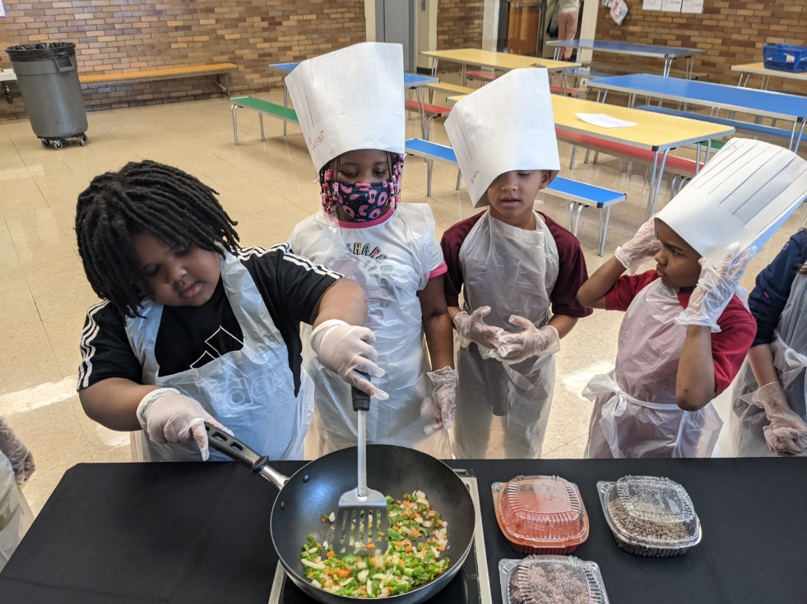
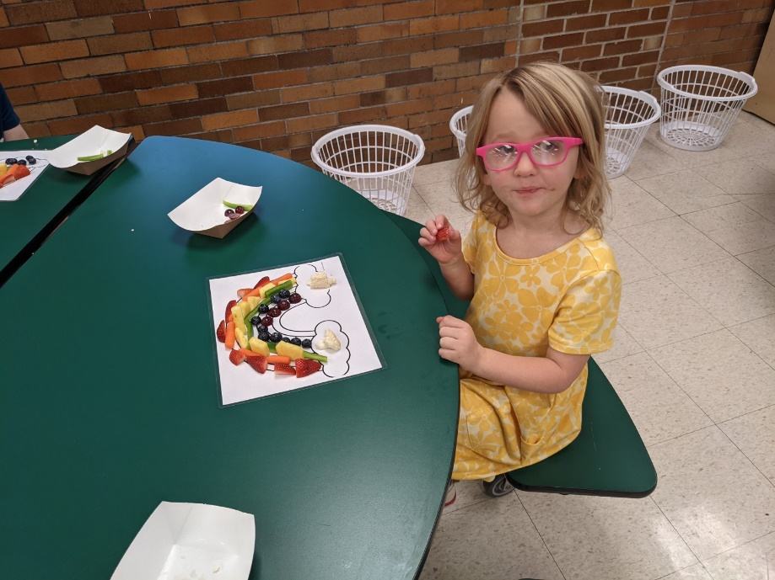
Questions
???
???
???
16

